Slide 1
Identity and Belonging
Building the Context

Slide 2
Who Am I? Major Factors Determining Identity
Ability- Learning, Social, Psychological, Emotional and Physical.
Age- Chronological, development, generational stages
Ethnicity- national origin, linguistic background, immigrant status
Gender- male or female

Slide 3
Factors determining Identity cont.
Race- anthropological categories such as Caucasian, Asian, African etc
Religion- major religious and cultural observances.
Sexual Orientation
Socio-Economic status- rich/poor

Slide 4
Factors determining Identity cont.
Situational factors- chronic illness, disability, family problems
Geographical Origin- national/regional, urban/rural/suburban
Marital status- single/married/divorced

Slide 5
Factors determining Identity cont
Physical Appearance- how we appear to ourselves and to others
Role and career- parent? Employed/unemployed? Working parent? Etc

Slide 6
Tasks
Question- What are the most important determining factors for the identity of a) a prep student, b) a 17 year old, c) a middle aged woman and d) a retired man.
Rank these factors from Most Important to least important.

Slide 7
Needs
1. What are human beings basic needs?
2. What do you really want? Does this impact on who you are?

Slide 8
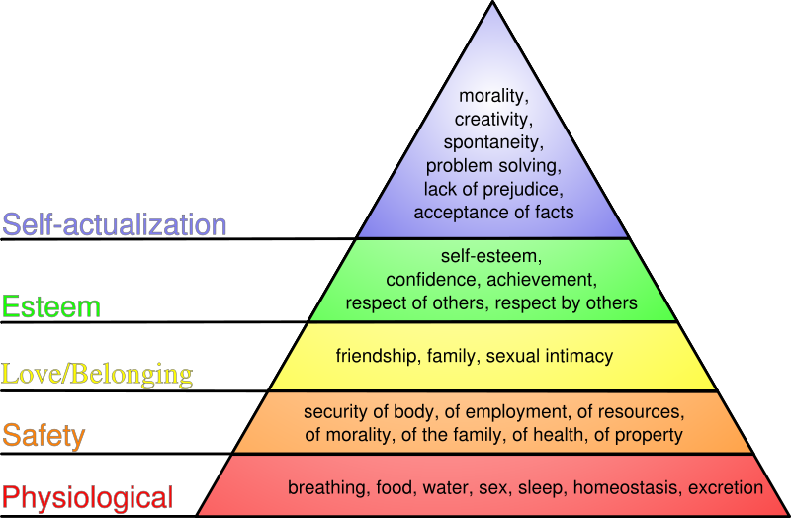
Maslow’s Hierarchy of Needs

Slide 9
Piaget’s Stages of Cognitive Development

